Slide 1
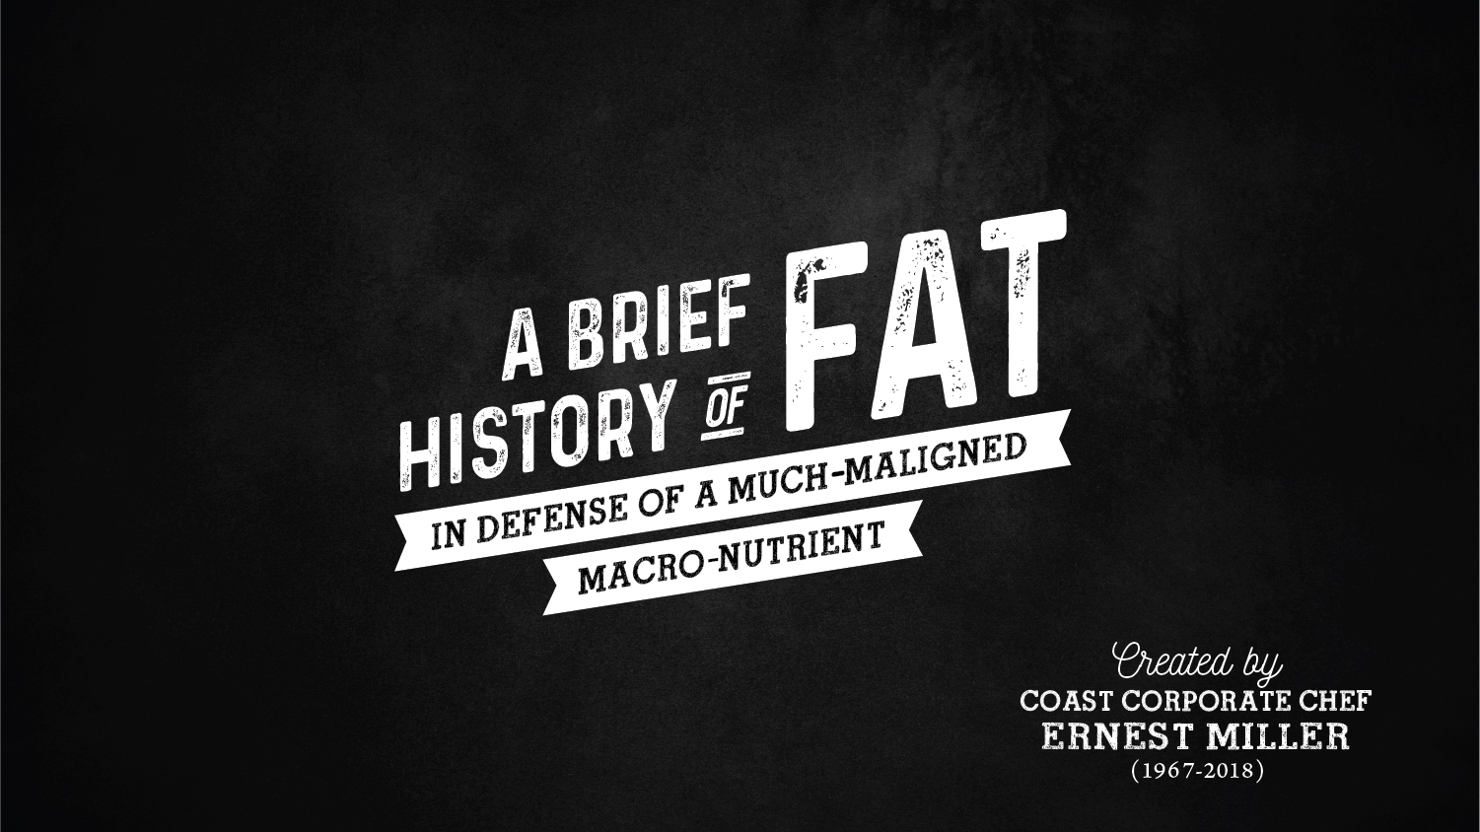

Slide 2
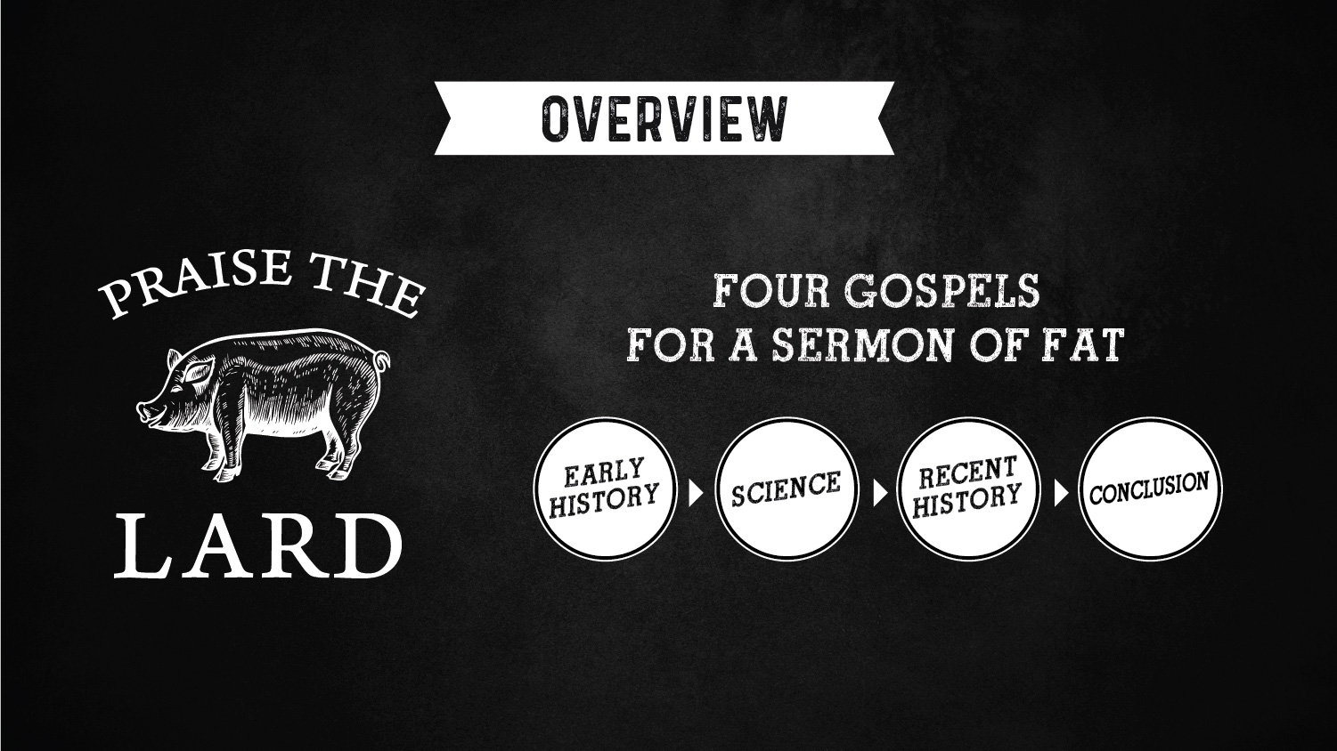

Slide 3
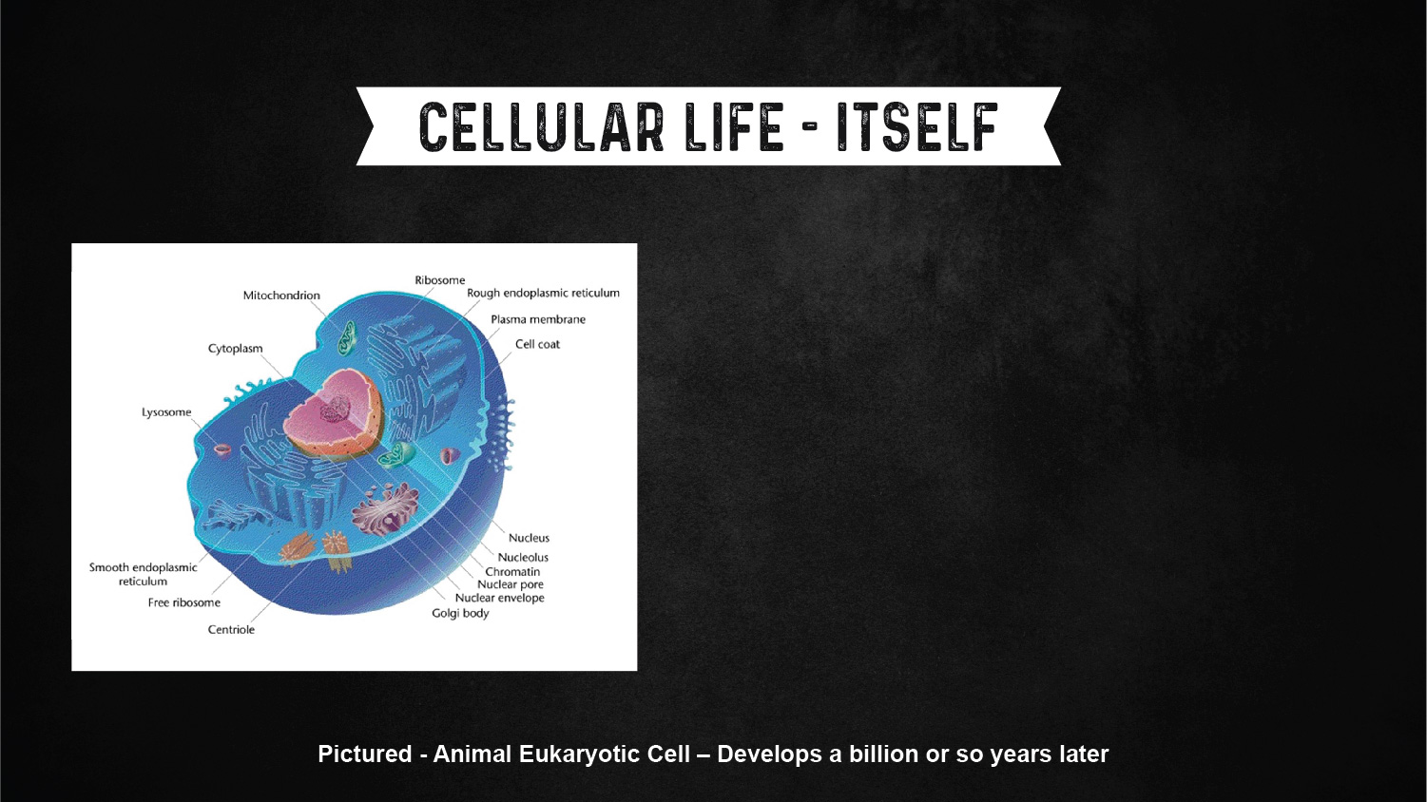
3.5 BILLION YRS AGO
Life, as we know it, is cellular.
Whether a single cell, such as bacteria, or tmulticellular, such as us, life is cellular.
What identifies a cell is the ability to distinguish what is the cell and what is not. To do this, a cellular membrane is required.
Those membranes are made from lipids. That is, fat.

Slide 4
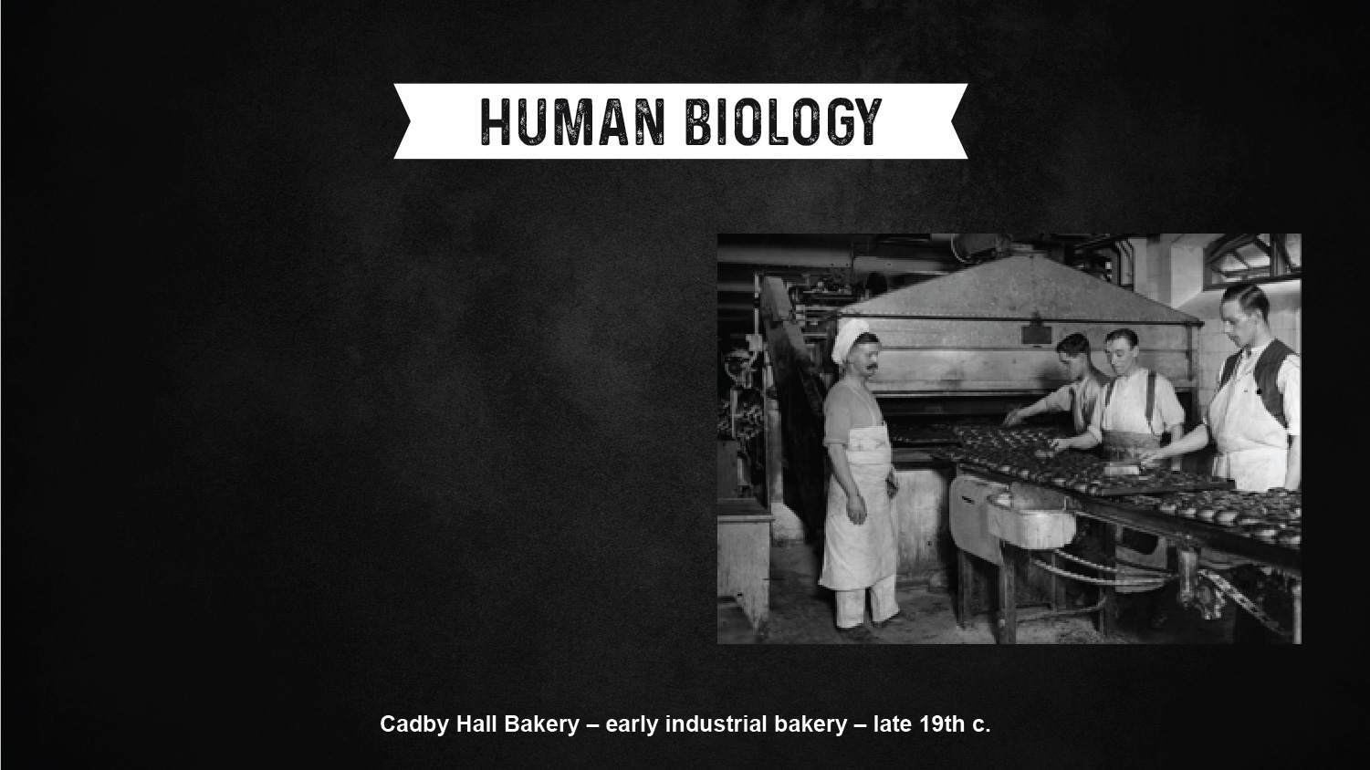
CALORIES ARE HARD
Humans are odd creatures.
We’re certainly not designed to be herbivores. Our digestive tracks are too short and it’s time consuming.
We’re not adapted particularly well to be exclusively carnivores either. Our teeth and livers aren’t really up to the task.
We’re mediocre omnivores at best. And brains are a really calorie-expensive organ.

Slide 5
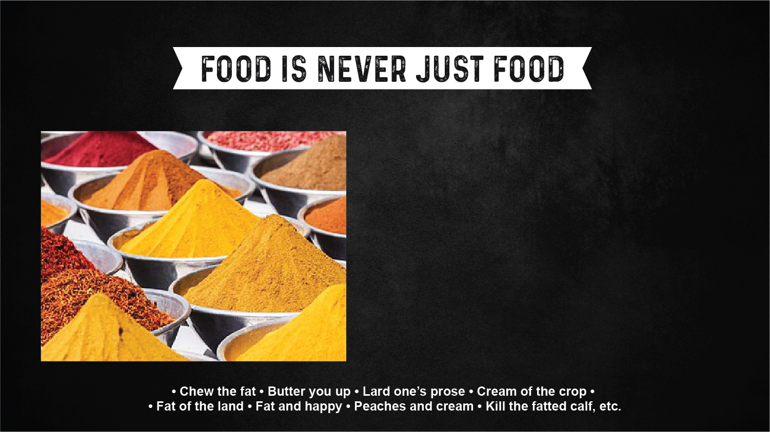
CULTURE
Energy dense fat, therefore, was favored.
Access to fat was an important marker of social and cultural status. Indeed, in religious ritual, the fat was offered to the gods. [Which actually meant that the priests were often the beneficiaries.]
We anoint with oil, sacrifice with ghee, recall the miracle of olive oil lamps during Hanukkah, feast with lard before Lent, and make use of it in many other cultural contexts.

Slide 6
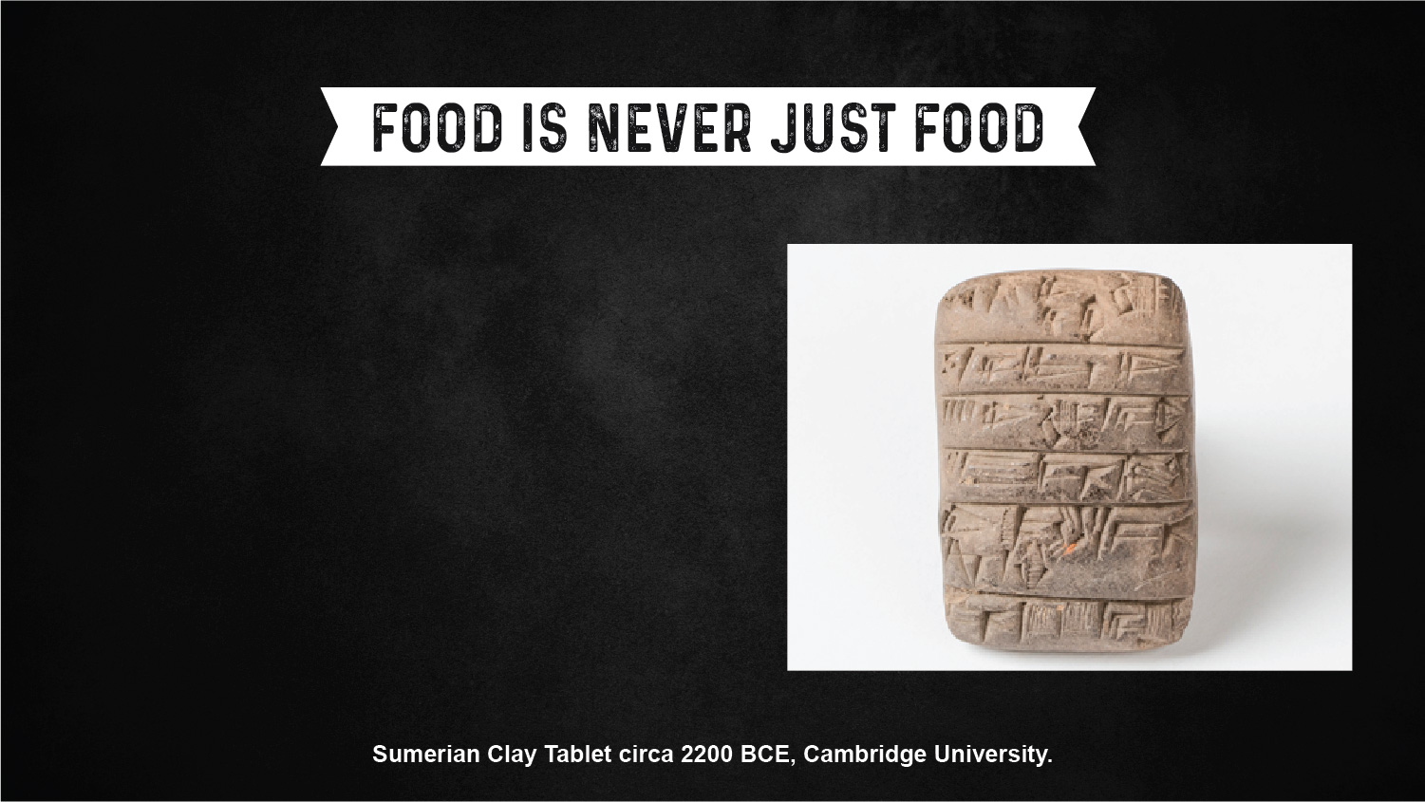
HISTORY
10,000 BCE Invention of butter
6,000 BCE Olives first pressed for oil
5,000 BCE Deep frying invented by the Egyptians
3,100 BCE Mesopotamians invent the copper frying pan
3,000 BCE Palm oil placed in tomb in Egypt
500 BCE Ancient Greeks deep fry food in olive oil
1879 CE Edison invents light bulb, tallow candles
finally on the way out

Slide 7
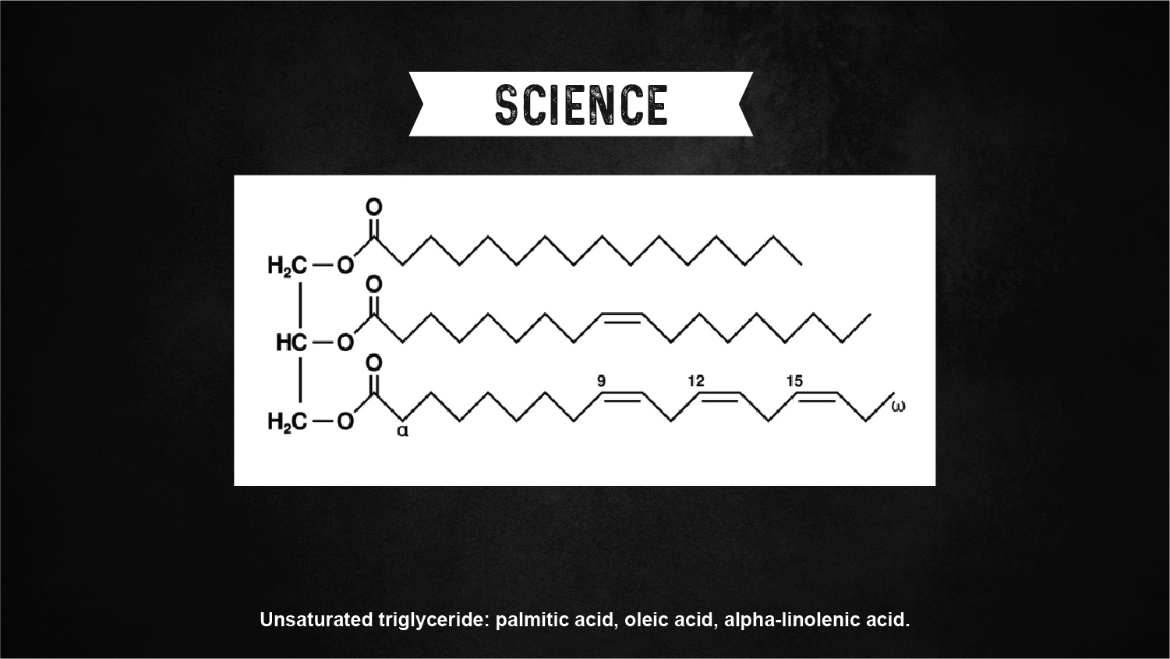
TRIGLYCERIDES & FATTY ACIDS
Saturated - Monounsaturated - Polyunsaturated

Slide 8
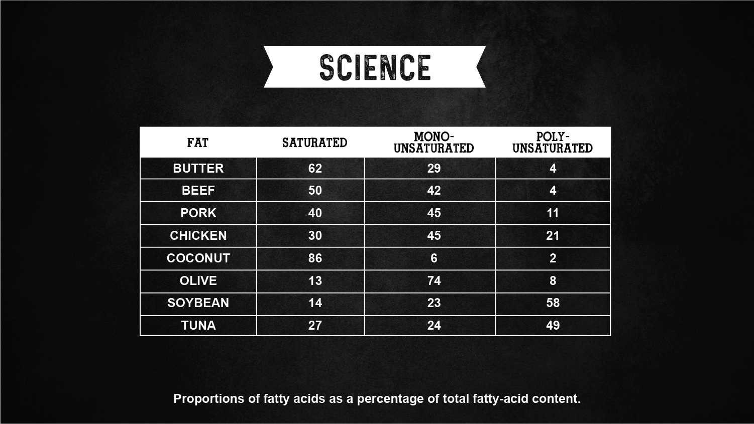

Slide 9
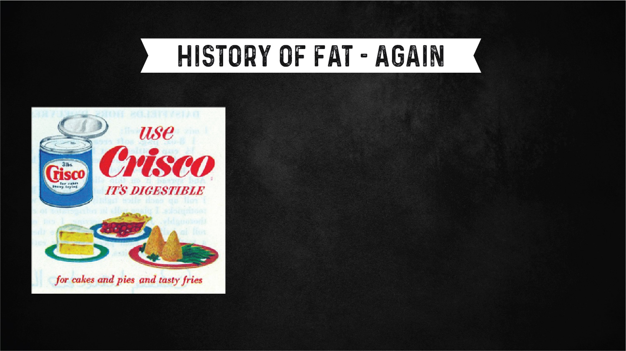
INVENTION OF CRISCO - 1911
IT WAS MEANT TO MIMIC LARD
Waste cottonseed oil is turned into a shortening through the use of the partial hydrogenation process and the creation of trans fats.
Through great marketing and economy there is a rapid rise to popularity.
Soybean oil will overtake cottonseed during the 1950s
Shortening – A fat that is solid at room temperature
Oil – A fat that is liquid at room temperature

Slide 10
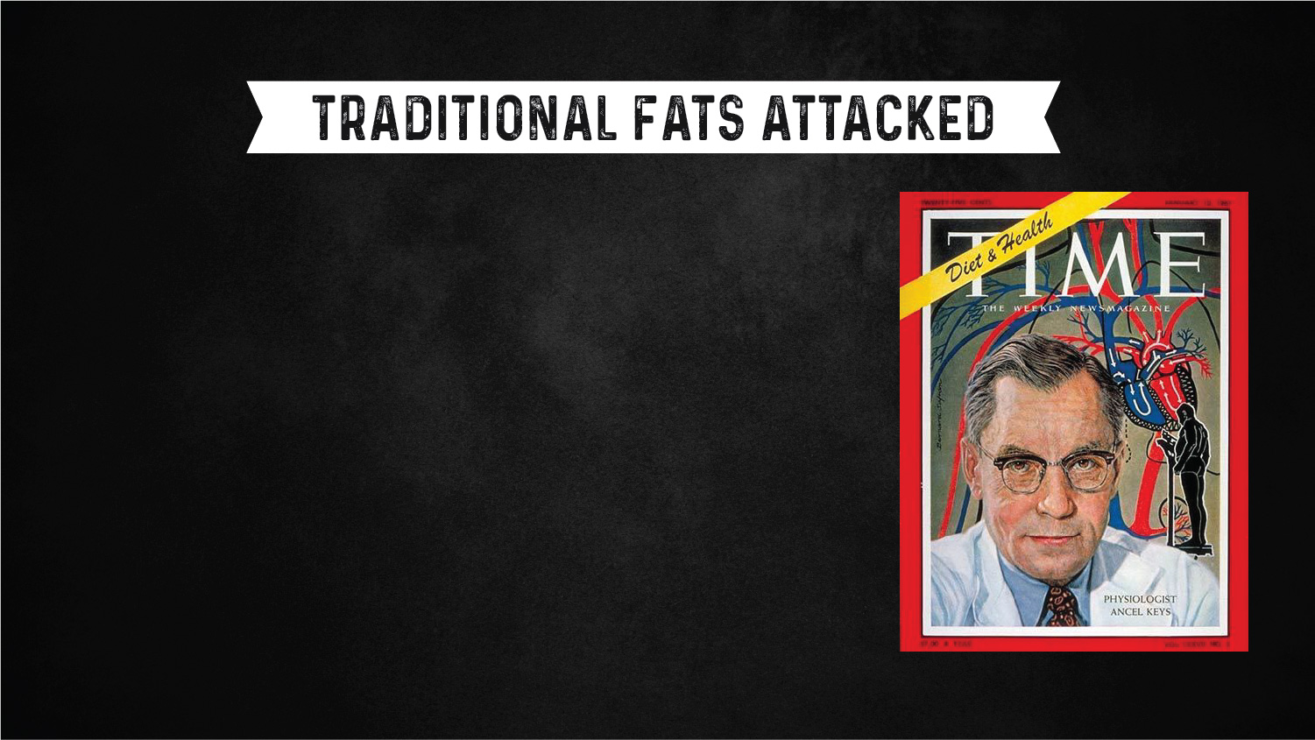
THE DIET-HEART HYPOTHESIS
DR. ANCEL KEYS - TIME MAGAZINE JAN 1961
In the 1950s, heart disease was a leading killer of middle aged Americans (white men, especially). Finding the cause became a priority.
Well-respected researcher Dr Keys postulated that it was consumption of traditional fats such as butter, lard and tallow, with high levels of saturated fats, were the primary cause.
Very influential in the American Heart Association, he convinced them to recommend a low-fat (featuring polyunsaturated fats) beginning in the 1960s.

Slide 11
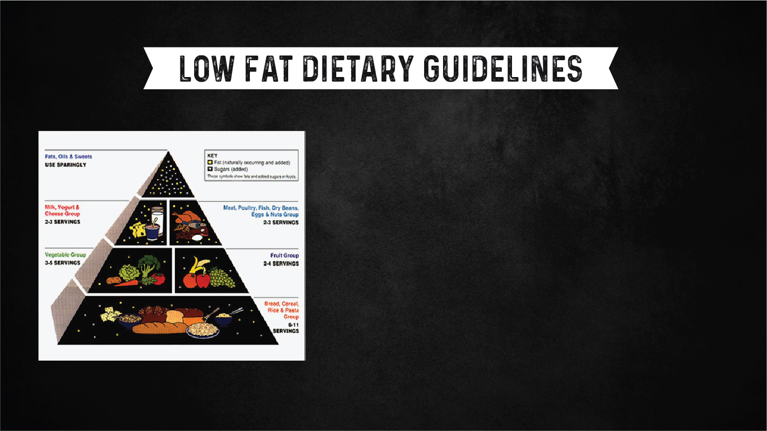
FIRST FOOD PYRAMID-1922
MY PLATE INTRODUCED 2011
In 1980, following the guidance of Sen. George McGovern, the USDA issued its first dietary guidelines for Americans. The USDA endorsed a low fat, high grain diet.
The guidelines have been updated every 5 years since, the last time in 2015.
Comments are currently being solicited for the 2020 edition.

Slide 12
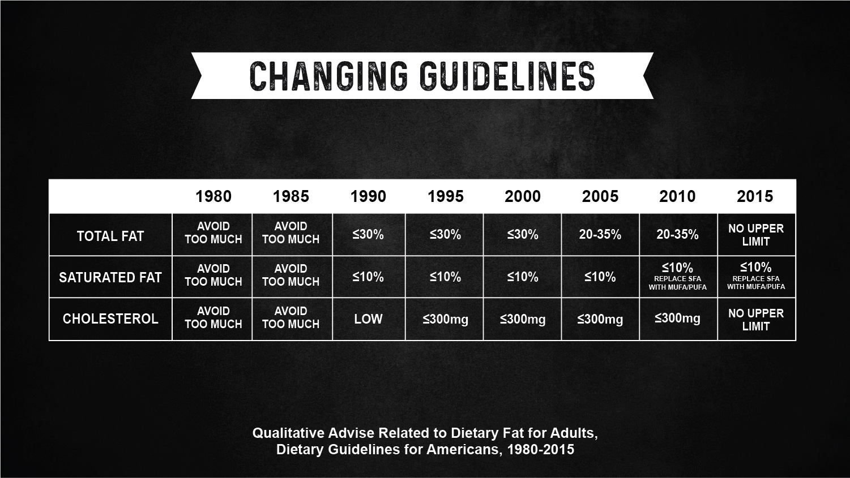

Slide 13
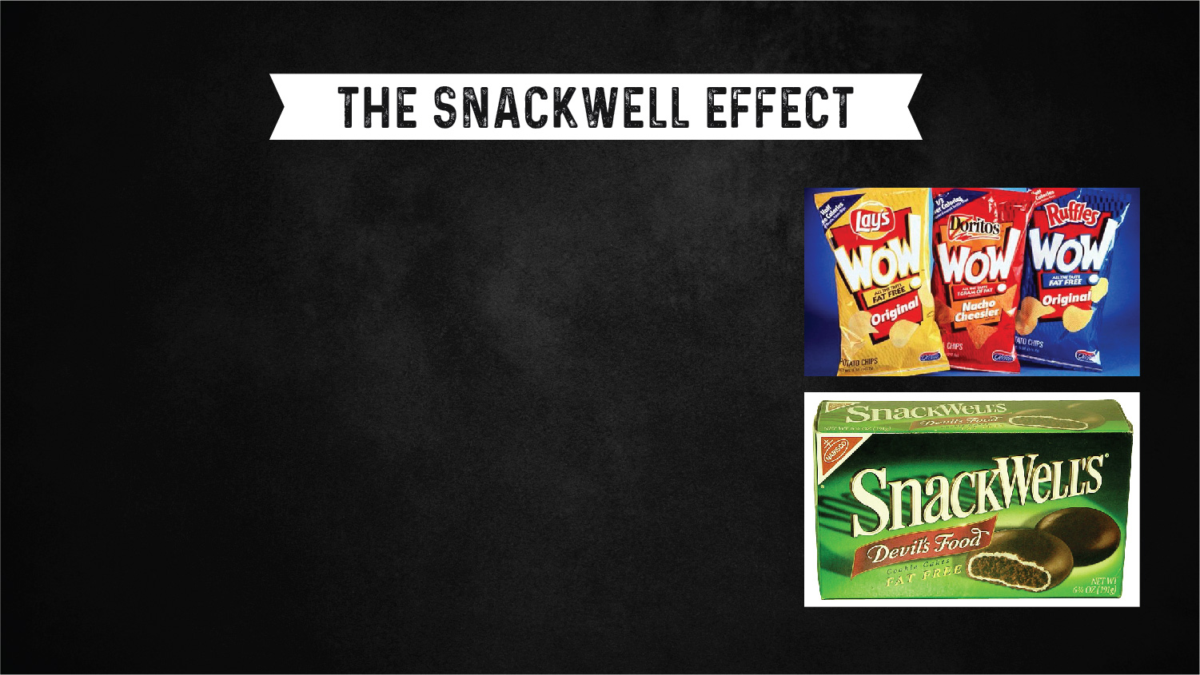
OLESTRA - FAT FREE POTATO CHIPS 1996
SNACKWELLS - FAT FREE COOKIES - 1992
In the 1990s fat was so thoroughly demonized that food manufacturers did everything they could to reduce or even eliminate fat in processed foods.
The results weren’t great. Reformulation often required significantly increasing sugars and other carbohydrates and the fat substitute Olestra made the phrase “anal leakage” famous.
Also, although Americans did decrease their consumption of saturated fats, obesity continued to increase and cardiac disease didn’t see much improvement.

Slide 14

CONFLICTING EVIDENCE ON FATS
STEARIC ACID - DOESN’T RAISE LDL CHOLESTEROL
Turns out, apparently, that nutrition science is complex and it may be that there is no one size fits all diet.
Break it down to specific fatty acids and it gets even more complex.

Slide 15
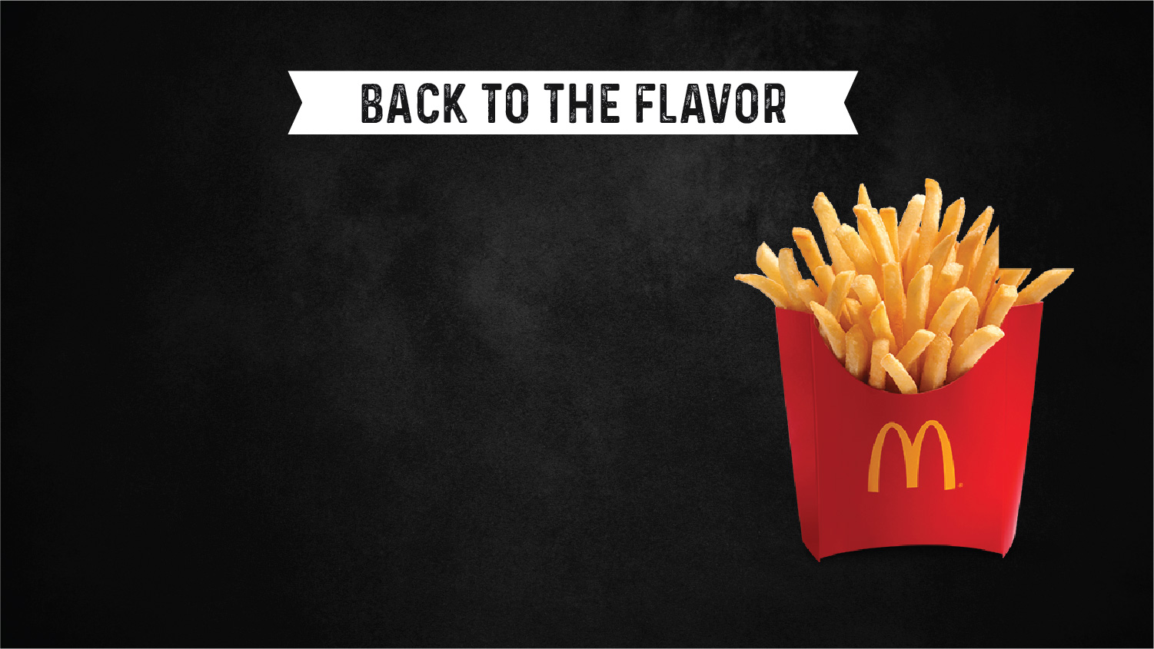
MCDONALD’S REMOVES BEEF TALLOW - 1990
BACK TO THE FLAVOR
At the height of the fear mongering about saturated fats, McDonald’s was targeted by activists for its use of beef tallow for its French fries. They switched to a vegetable oil in 1990 and the fries have never been the same since.
Fat is flavor.
Heritage cooking fats, like lard and beef tallow, bring umami to the plate.
As has been said, great fried chicken requires liquid swine.

Slide 16
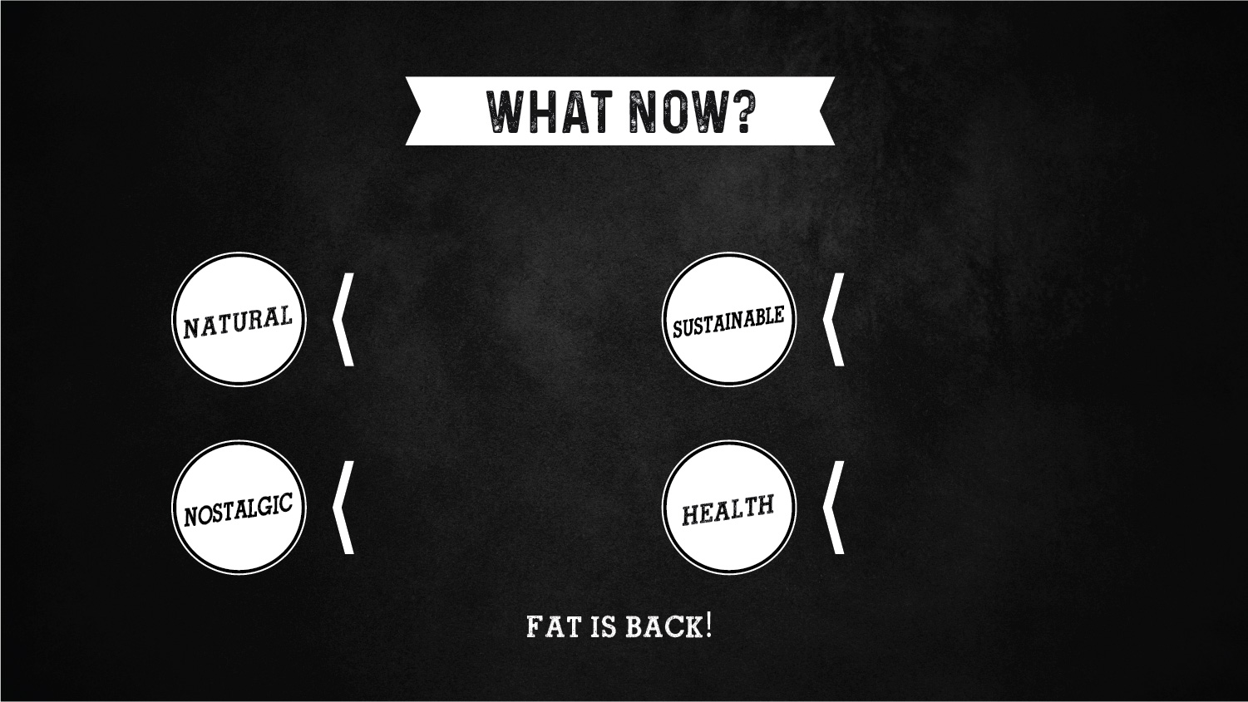
Heritage cooking fats were around long before substitutes were invented
Eco-friendly? Thy name is heritage cooking fat.
Cook like your great-grandmother. (Hint: she used heritage cooking fats)
The most popular diets feature heritage cooking fats. Keto, paleo, Atkins, etc.

Slide 17


Slide 18
